Slide 1
Strategic Account management
How to realize Higher REVENUE at Accounts with a Strategic Value

Slide 2
Content
High level Sales & Buying cycles
Vision
Kind of accounts and approach
What is needed to make a good plan.
Content of an account plan
Outcome of the account plan
Share best practices
More value for you

Slide 3
The Sales Tunnel
Prospects
Interesting projects
Visit(s)
Offer
Negotiation
Order

Slide 4
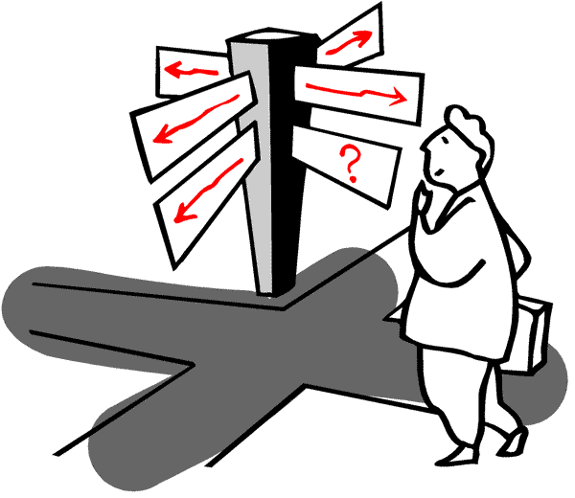
Approach Accounts Attitude
CSO Insights 2017 Sales Enablement Optimization Study
33 % formal approach
>10% no account planning
>20 % random approach lead by SPOC
=>> Impact on your T.O. & margins

Slide 5
Vision Strategic Account Management
From COLD prospects to Interesting projects
Strategy
  Direct sales
  Indirect sales
Find the match
  N……
  C……
  D……
  O…….
  =>More value what we offer
Keep in the driver seat

Slide 6
Networking : Who is in contact with who?
 | Direction | Sales | Production | Technical S | Supply | SHEQ | Finance
Direction | X | X
Purchase |  | X |  |  | X |  | X
Production |  | X | X | X | X | X
Technical S |  | X | X | X |  | X
Supply |  | X |  |  | X | X
SHEQ |  | X | X | X | X | X
Finance |  | X |  |  |  |  | X

Slide 7
Account Plan : Content
Account’s issues & strategies (global- local)
Swot (global – local) of the customer and of the (potential) relation
Objectives (global – local)
STRATEGY based on information customer and goals company
  F…….. projections
  R… & D…
  A….. programs with T….. & D…..
  Monitoring & Correction
Additional information & Q……

Slide 8




What’s in for you?
Strategic account plan is the lead for strategy for this account over the coming months/year
  Focus
  Earn time and money
Customer experiences a higher involvement of your company
  PREFERRED PARTNER
Teambuilding & Common Succes
Happy people deliver happy results deliver happy people

Slide 9


Let’s start to build /extend (new) Partnerships.
Prepare
Execute
=> Higher Sales - Margins
If you need full presentation or supplementary info contact :
Johan@3Lefs.com
+32 472 700 750

